Slide 1
Diabetes Supervised Learning
By: Omar Obitdat and Jesse Parron

Slide 2
Introduction
In this project we implemented supervised learning by utilizing SVM (support vector machines) and Logistic Regression.
The goal of this project is to use supervised learning to predict if a person has diabetes or not.
We establish methods of data preparation such as standard scaling, filling missing values, and Dimensionality Reduction. Then we used hyperparameters to fine-tune the data, and evaluated it using the confusion matrices, classification report, and scores.

Slide 3
Description of Dataset
Semantics of the columns:
1. Pregnancies (Numeric value).
2. Glucose (Numeric value).
3. Blood Pressure (Numeric value).
4. Skin Thickness (Numeric value).
5. Insulin (Numeric value ).
6. BMI (Numeric value)
7. Diabetes Pedigree Function (Numeric value)
8. Age (Numeric value)
Utilizing Kaggles we found a dataset for Diabetes. It contains 8 features and 1 target variable. The dataset contains 769 rows, with 9 columns.
The data is split to: Features: Pregnancies, Glucose, Blood Pressure, Skin Thickness, Insulin, BMI, Diabetes Pedigree Function, Age.
Target: Outcome - if the patient has diabetes or not.
Source: https://www.kaggle.com/datasets/mathchi/diabetes-data-set

Slide 4
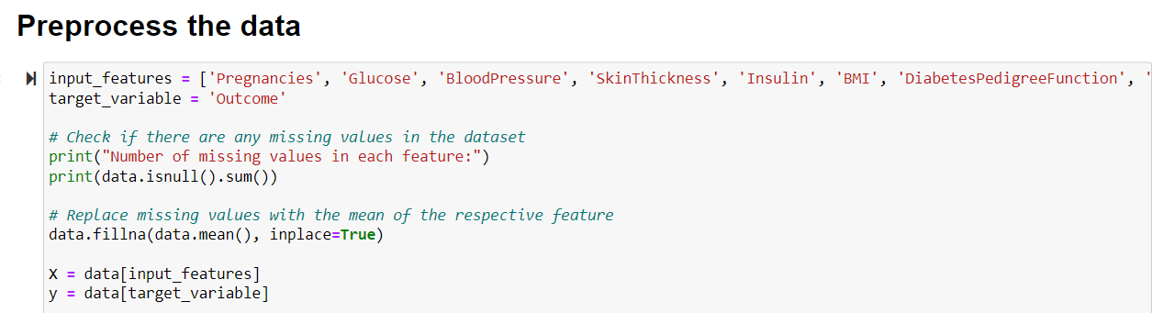
Data Preprocessing

Slide 5
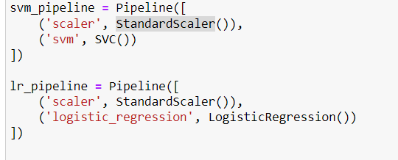
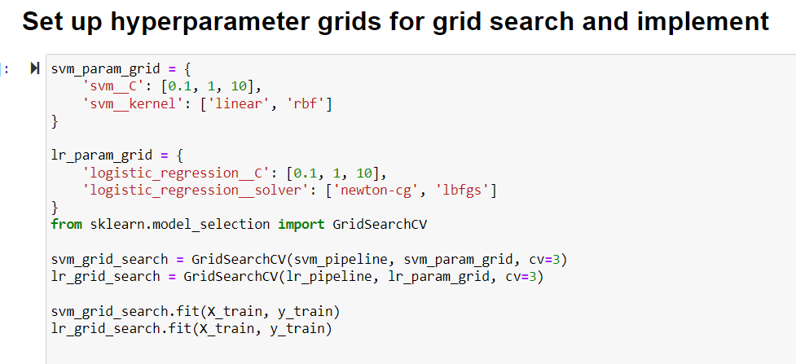
Data Preparation
For data preparation we first utilized standard scaler in order to scale the values of the data since the dataset is fully numerical.
We then created pipelines for both the SVM model and the Logistic regression model. Afterwards we then implemented hyperparameters using gridsearchCV.

Slide 6
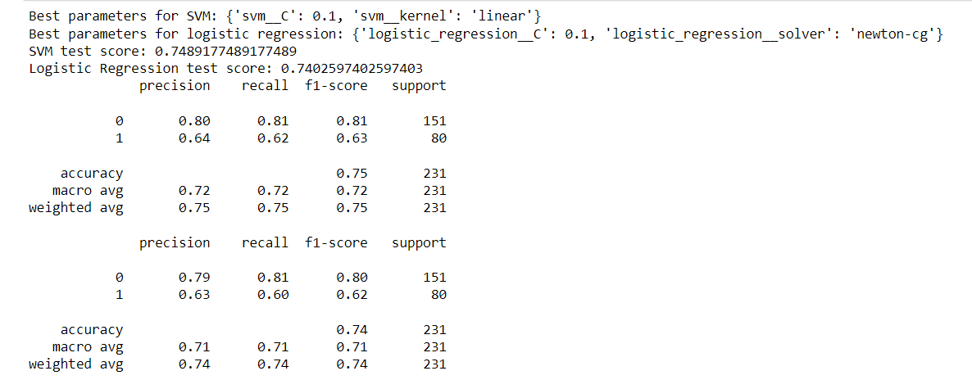
We Evaluate The Data

Slide 7
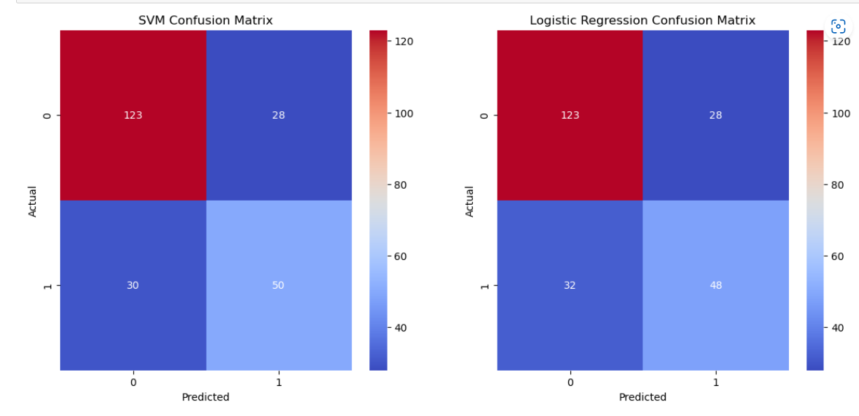
Visualize The Data

Slide 8
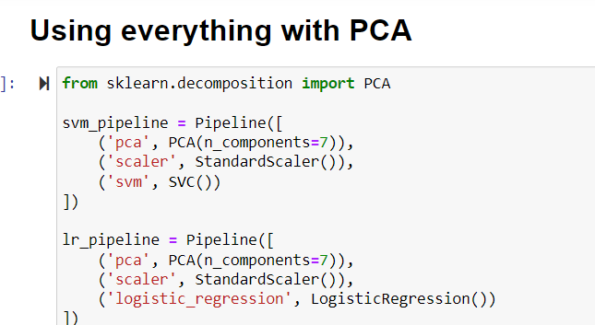
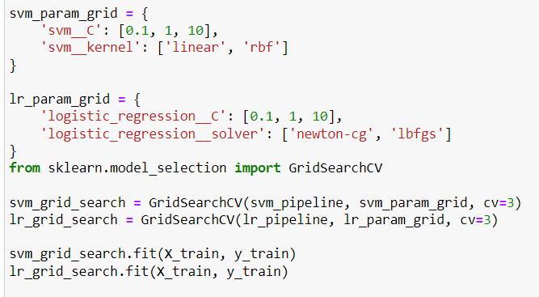
We Utilize Advanced Data Preparation Techniques

Slide 9
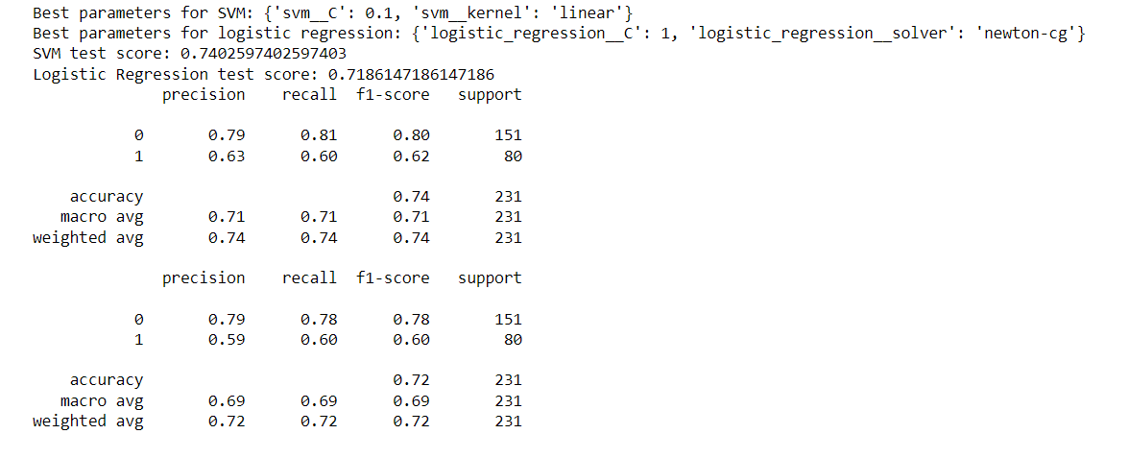
Evaluating The PCA Result

Slide 10
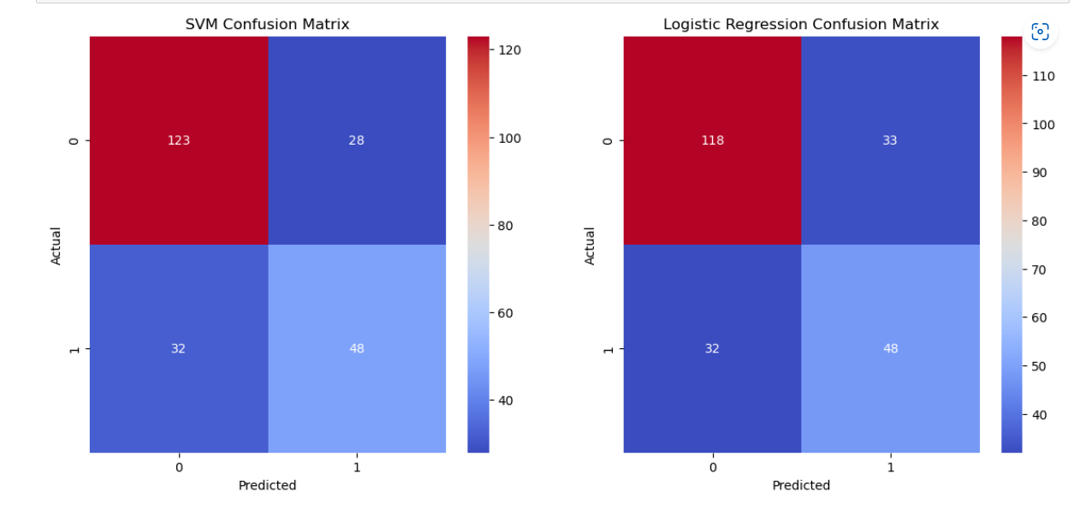
Visualizing the Data

Slide 11
Conclusion
After analyzing and discussing the Support Vector Machines and Logistic regression models with and without advanced data processing techniques. We can see that without the implementation of PCA, the models performed overall better. Without they both reached a score of 74% while with PCA, SVM reached 74% while logistic regression reached 71%.

Slide 12
Live Demonstration

